Slide 1
How to Annotate a Poem

Slide 2
Why do we Annotate? (don’t copy this)
To “annotate” means to add notes, explain, or comment
We annotate poems so that we can understand the meaning
Sometimes you can read a poem once, pick up a few pieces of information, but miss the rest because they are hidden
(hidden in figurative language- a flower is not always a flower. A thunderstorm does not only indicate rain is coming).
Remember, poetry is up to the reader’s interpretation, your ideas might not match someone else’s, but it should enhance theirs.

Slide 3
How to Annotate (copy this down)
Read the entire poem once.
Read it again. In your head, try and grasp the basic meaning.
Underline and identify as many poetic devices as you can.
On your paper, and with lines connecting to the passage to which you are referring, explain the possible meaning. Every line if you need to; write on the left and right side of the page.
Afterward, go through and explain your interpretation of the poetic devices.
What is that metaphor indirectly comparing?
What could that symbol represent?
How is that assonance used?

Slide 4
How to Annotate cont’d
From your newfound knowledge of the meaning of the poem, which may be completely different from someone else’s, begin to infer/suggest/imply meaning of lines, stanzas and the poem altogether.
Your paper should be covered in ink.
Remember: poetry is subjective. Your understanding depends on your background knowledge, your emotional state at the time of reading, and your own upbringing. Don’t back down, if you have an intelligent explanation of the meaning of a poem, who’s to tell you you’re wrong?

Slide 5
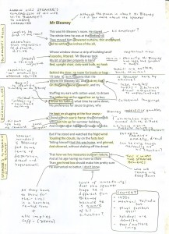
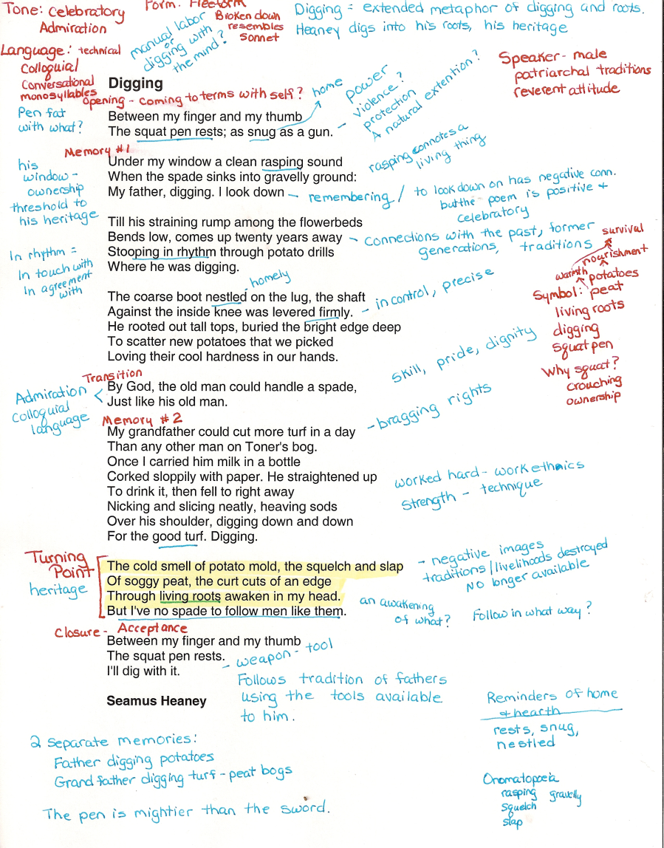
It should look like this:

